Slide 1

Building a Review Analyzer with NLP
Presented By:
T. Pranitha(217Z1A05H4)
S. Sai Sridhar Naidu(217Z1A05G6)
T. Madhava Swamy(217Z1A05H6)
Guide Name:
Dr. G. Sravan Kumar

Slide 2

List of Contents
Abstract
Introduction
Existing system
Proposed system
Requirements specification
Design architecture
Modules
Result
Conclusion

Slide 3
ABSTRACT
This project focuses on creating a system for analyzing customer reviews through sentiment analysis, opinion mining, and aspect-based classification. It will categorize reviews as positive, negative, or neutral, helping businesses understand overall customer feelings.
By converting raw text into structured insights, the analyzer helps restaurant businesses and consumers understand review trends more effectively. Additionally, the application generates a real-time sentiment distribution graph for visual analysis.
Supports real-time feedback monitoring across various industries like e-commerce and hospitality.

Slide 4

INTRODUCTION
1
Business Impact
2
Evolving needs
Review analysis importance for businesses.
Challenges in traditional review classification.
3
Machine Learning
Role of ML models in review analysis.

Slide 5

EXISTING SYSTEM
Manual review analysis
Time-consuming, inconsistent results
Rule-based sentiment analysis
Limited accuracy and adaptability

Slide 6





PROPOSED SYSTEM
Machine Learning
ML for review classification.
Restaurant Reviews
Pre-trained model for higher accuracy.
Real-time Tracking
Automated sentiment monitoring.

Slide 7




REQUIRED SPECIFICATIONS
Python
Python programming language is used
Spacy
It is a NLP library designed for processing and analyzing human language
Flask
It is a web framework used to build web applications and APIs

Slide 8
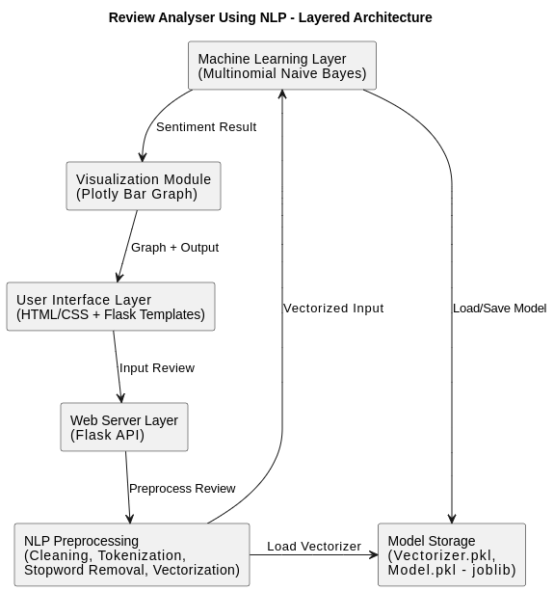
DESIGN ARCHITECTURE

Slide 9
Data Collection
Data Pre Processing
Model Training
User Interface
Prediction
Visualization
MODULES

Slide 10
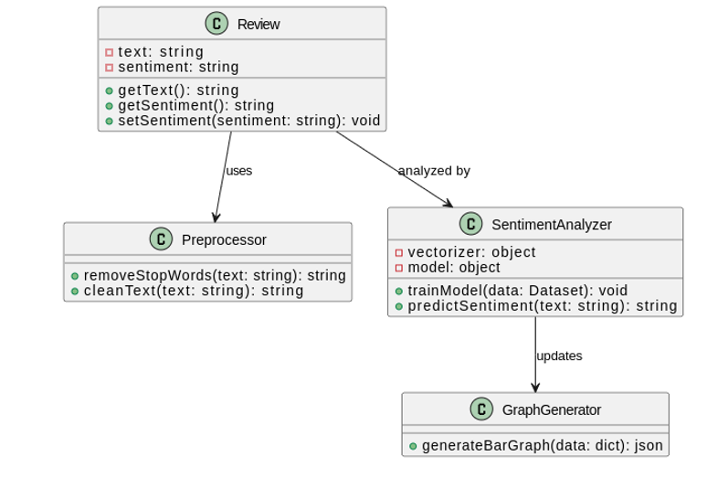
CLASS DIAGRAM

Slide 11
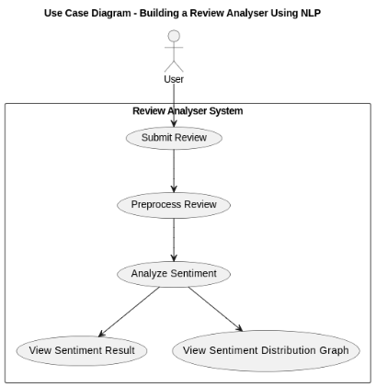

USECASE DIAGRAM

Slide 12
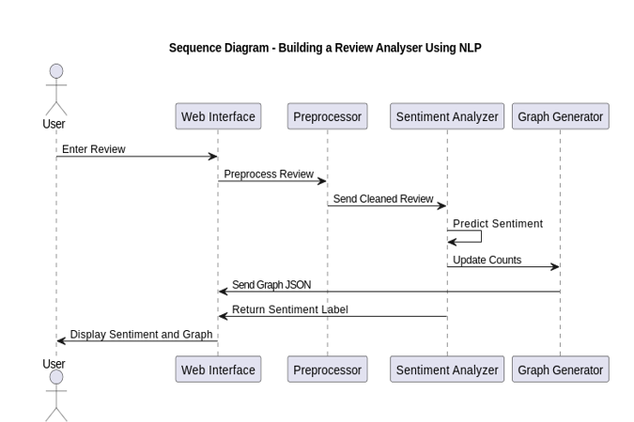
SEQUENCE DIAGRAM

Slide 13
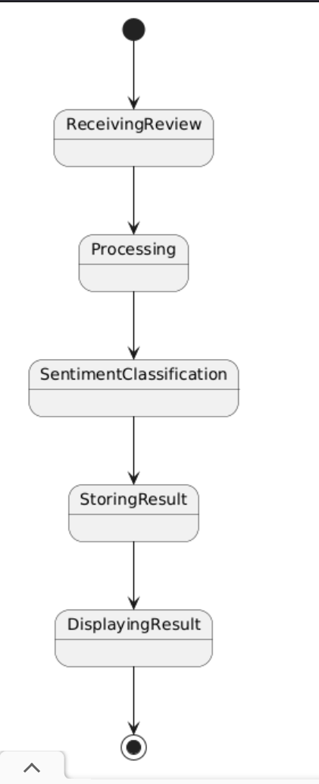
STATECHART DIAGRAM

Slide 14
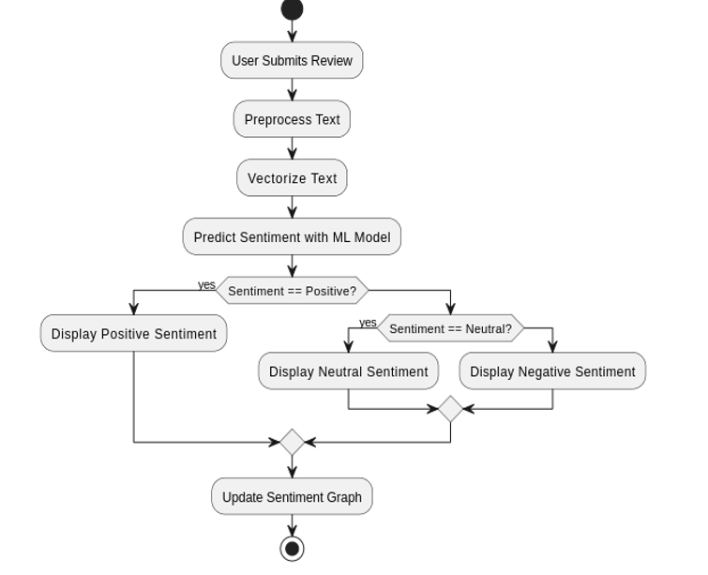
ACTIVITY DIAGRAM

Slide 15
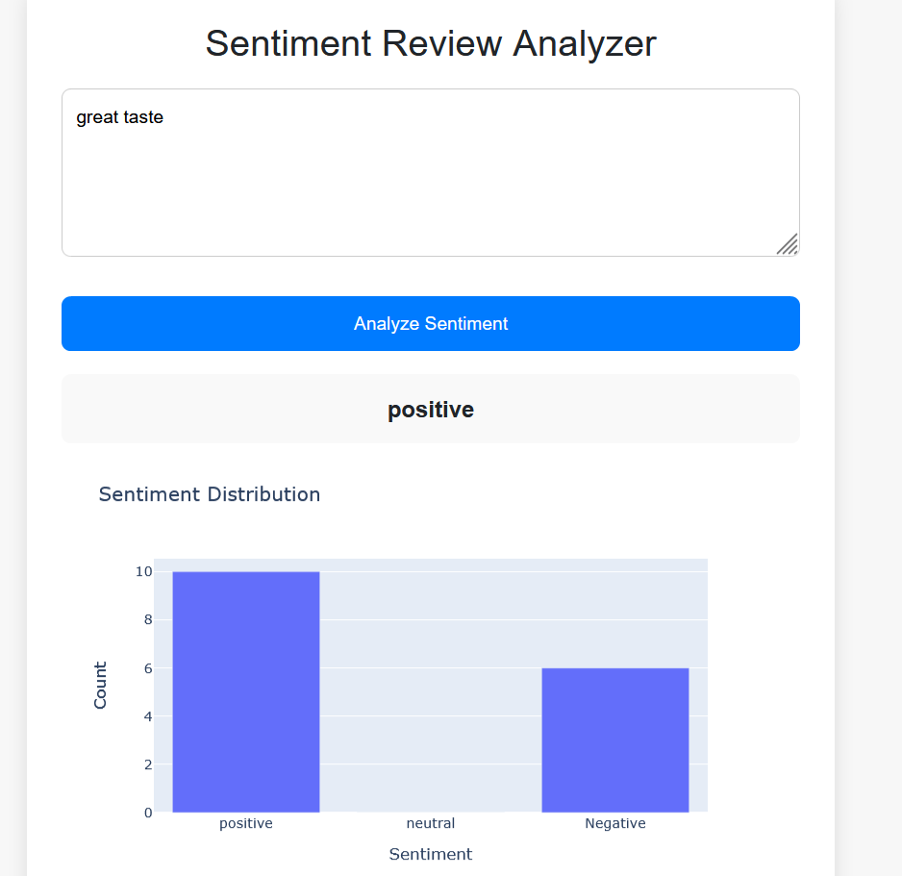
RESULTS

Slide 16
CONCLUSIONS
Improved Accuracy
Real-Time Benefits
Future Scope
Machine learning enhances sentiment analysis accuracy.
Supports better decision-making.
Expand to multilingual & real-time monitoring.

Slide 17
Thank You

